Slide 1
Incremental Timing-Driven Placement With Approximated Signoff Wire Delay and Regression-Based Cell Delay
Presenter: Chien-Yi Yang
IEEE Trans. VLSI Syst, VOL. 27, OCTOBER 2019
Tai-Cheng Lee and Yih-Lang Li
The Electronic Design Automation Laboratory
Graduate Institute of Electrical Engineering
National Taiwan University
Taipei 106, Taiwan

Slide 2
Outline
Introduction
Algorithms
Experimental Results
Conclusion

Slide 3
Outline
Introduction
Algorithms
Experimental Results
Conclusion

Slide 4
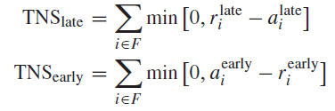




Circuit Timing Measurement
Total Negative Slack
r: required time, a: arrival time
Worst Negative Slack
Net Delay (Elmore Delay)
k: 1 or 0.69
Net Delay After Movement

Slide 5
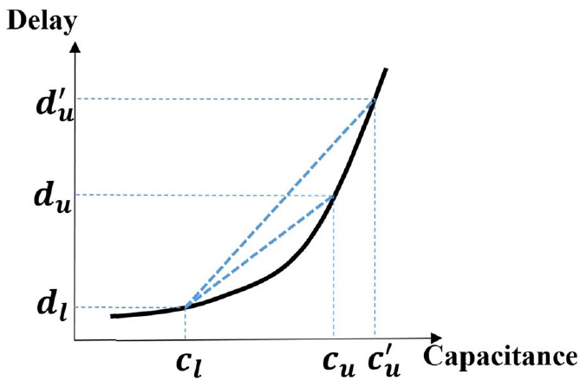



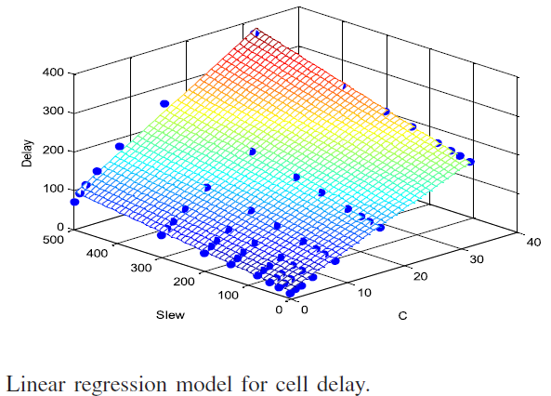

Circuit Timing Measurement
Input Slew After Movement
Cell Delay After Movement
Model Construction

Slide 6
Outline
Introduction
Algorithms
Proposed Flow
Dynamic IR drop prediction
Dynamic IR drop aware cell movement
Experimental Results
Conclusion

Slide 7
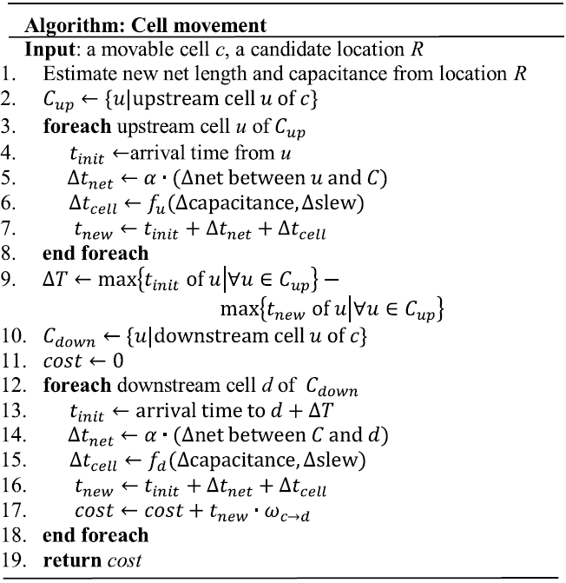
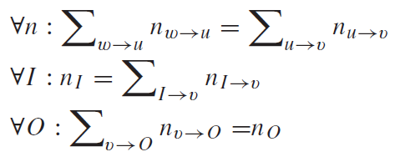
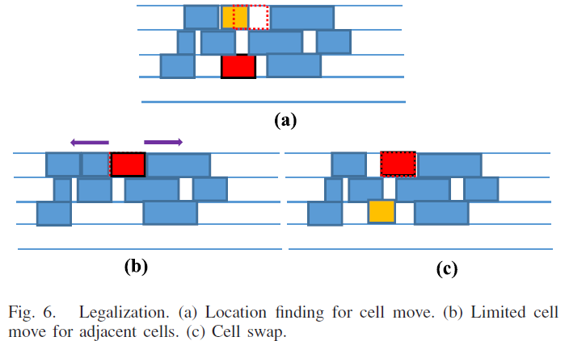
Design Flow With Violation Path-Based Net Weighting
Lagrangian Relaxation
Constraints
Candidate Selection

Slide 8
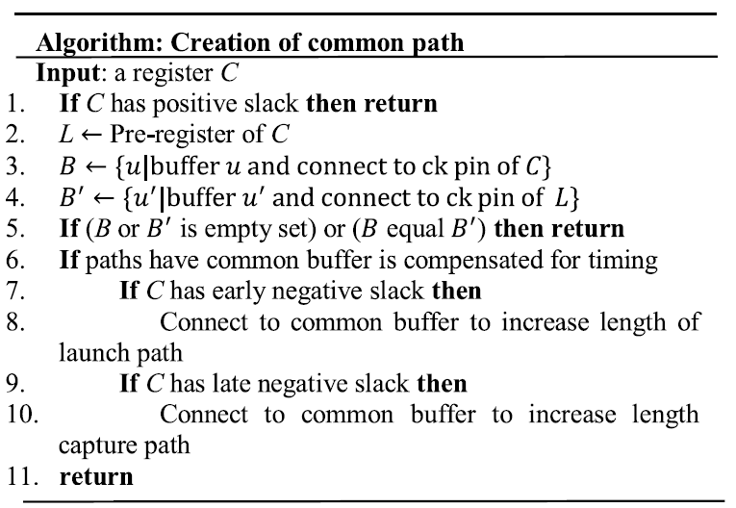
Clock Tree Adjustment
Creation of Useful Clock Skew
Time Borrowing
Launch path or capture path adjustment
Creation of Common Path

Slide 9
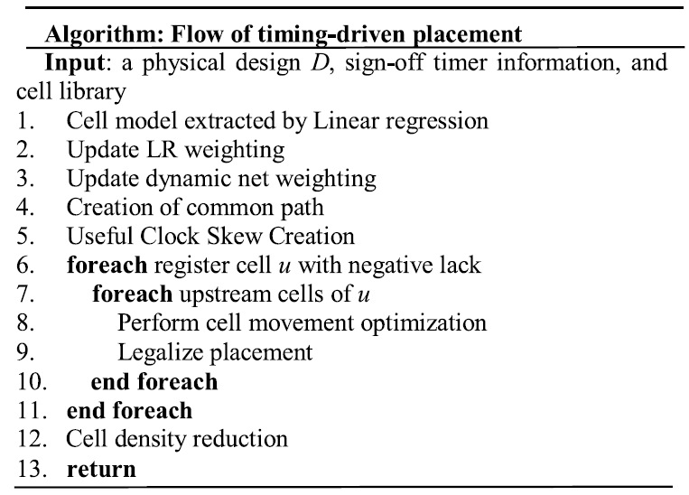
Algorithm Flow

Slide 10
Outline
Introduction
Problem Formulation
Experimental Results
Conclusion

Slide 11
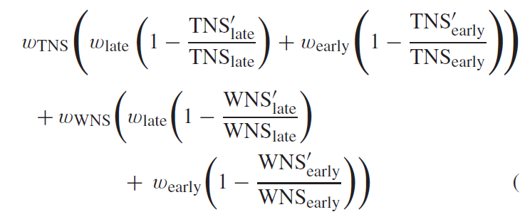

Experimental Settings
Language & libraries
Programming language: C++
Compiler: g++ 4.9.2
Platform
Linux machine with Intel Xeon 3.0 GHz CPU and 48 GB memory
Evaluation Metric
Benchmark
ICCAD2015

Slide 12
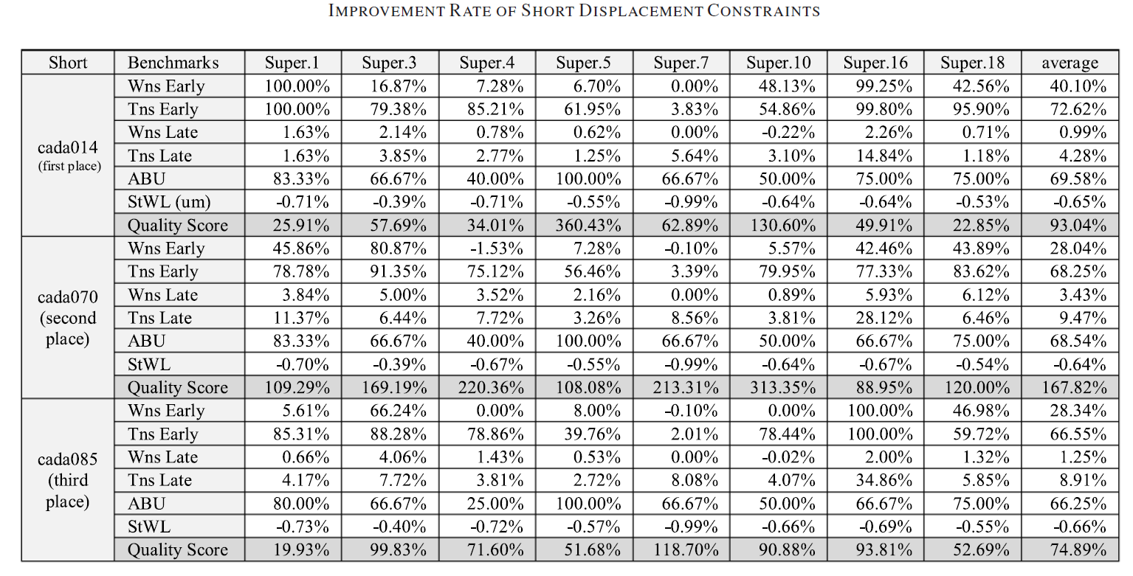
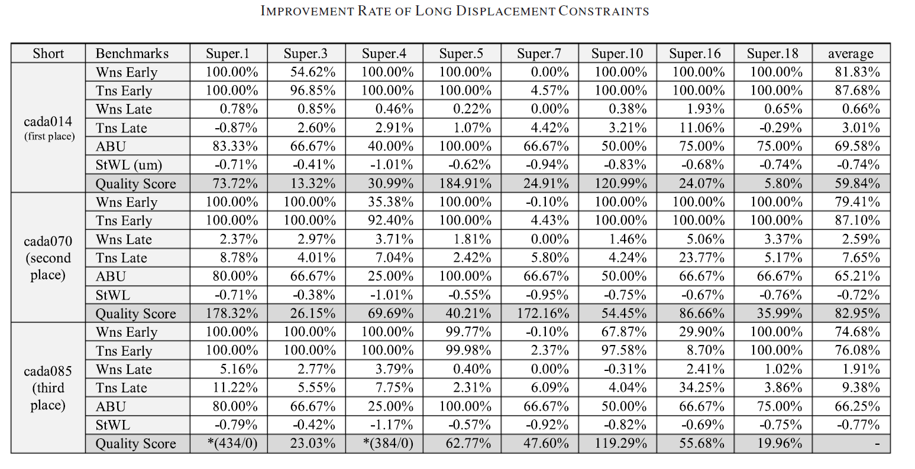
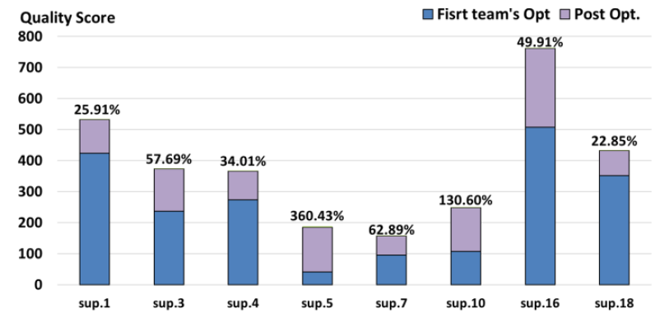
Postoptimization Results

Slide 13
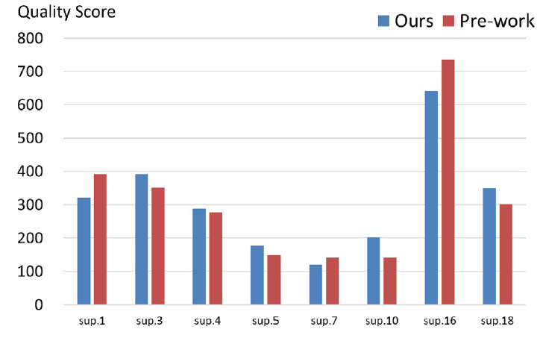
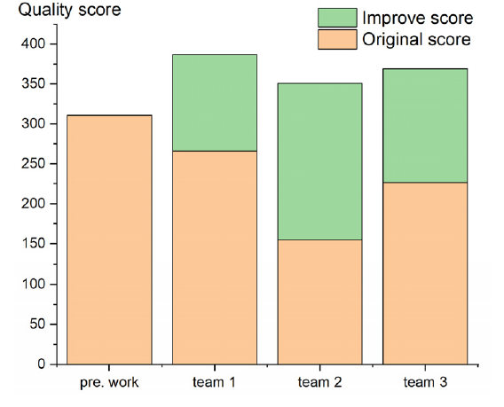
Results Comparisons

Slide 14
Outline
Introduction
Algorithms
Experimental Results
Conclusion

Slide 15
Conclusion
Proposes approximation models for signoff timer information and nonlinear cell libraries
Adjustment of the clock tree and the modified weight of LR help to ensure that the timing violations of design are diminished

Slide 16

Thank You!

